Slide 1
Titan Games & Hobbies: Magic the Gathering Database
Sam Bishop, Mike Mason, Dieringer Scott, Rashid Talib

Slide 2
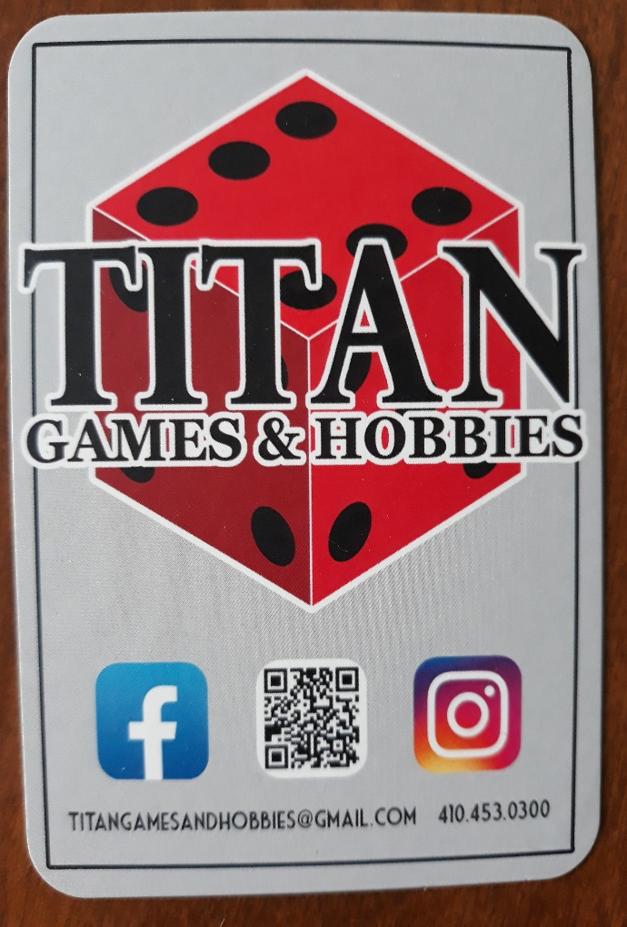
Business Background & Requirements
Titan Games & Hobbies wanted a database that:
Stores MTG cards and all pertaining info
If possible, store customer information
Database needs to be “user friendly and intuitive”
Card process is based on the buying and selling of MTG “singles”

Slide 3
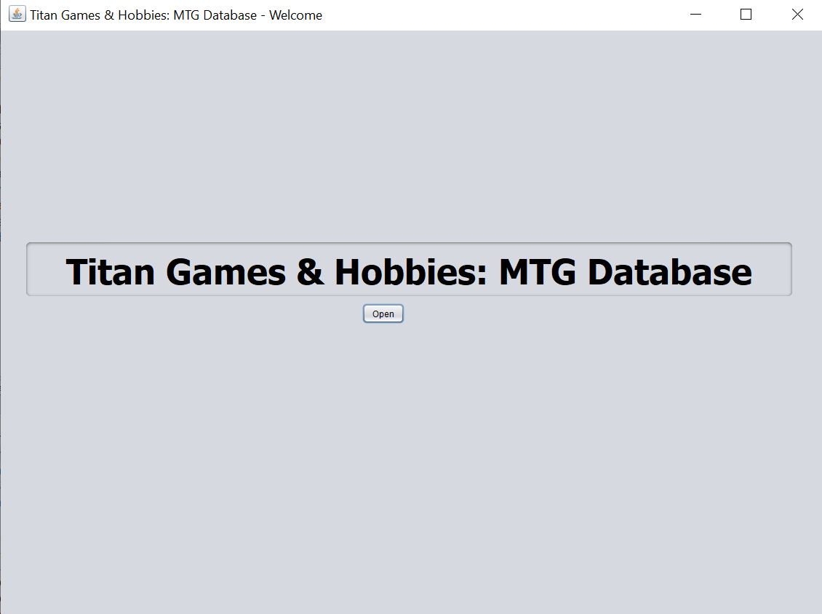
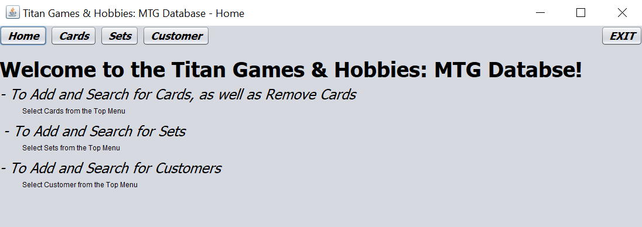

Slide 4
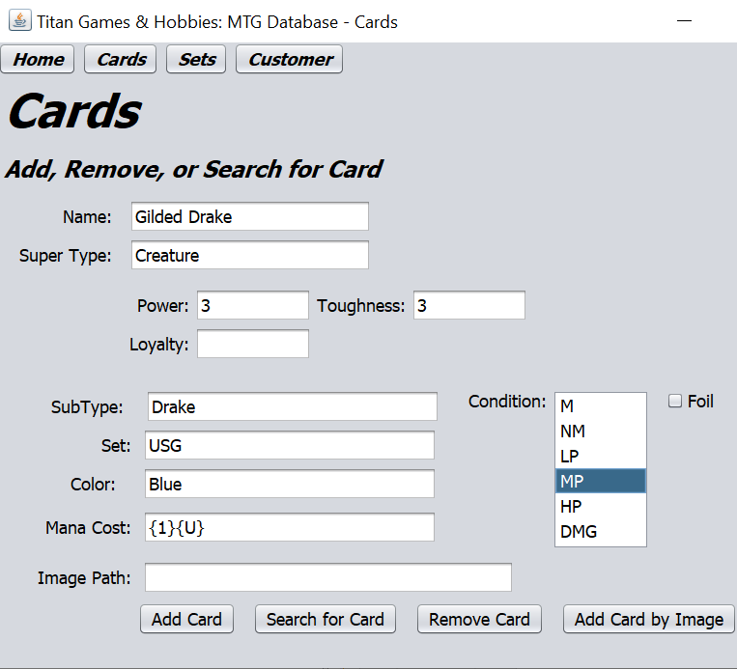
Card Page
Allows user to enter all needed information on cards
A card can be…
Added
Searched for
Removed
Or Added by Image

Slide 5
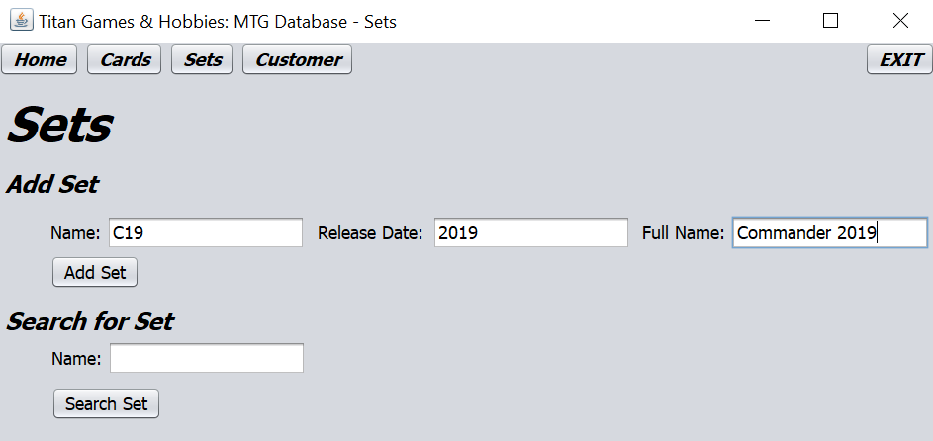
Set Page
Allows you to enter sets that cards are a part of, as well as search for sets

Slide 6
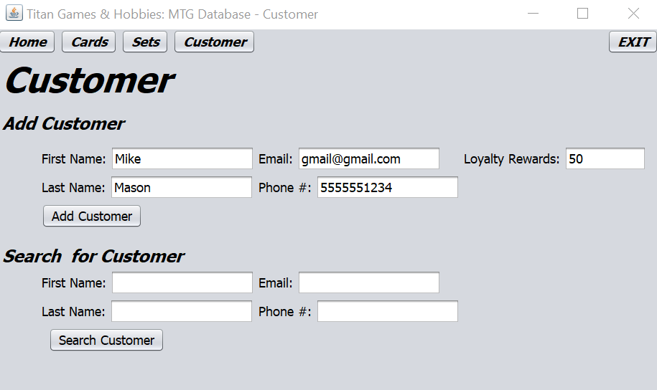
Customer Page
Allows a Customer to be added or searched for

Slide 7
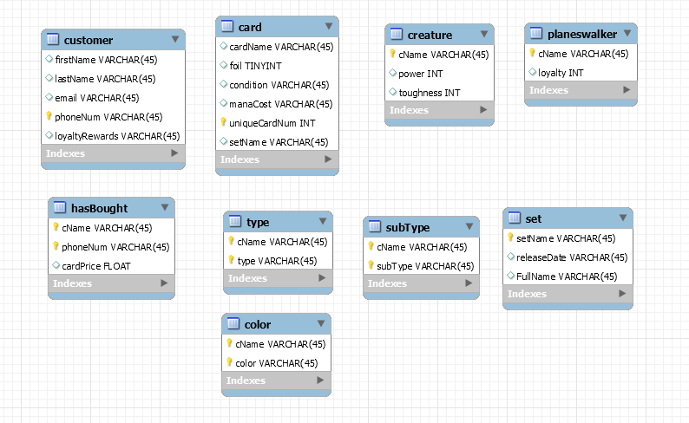
Tables in Database

